Slide 1


DEPARTMENT OF COMPUTER SCIENCE & ENGINEERING
SCHOOL OF COMPUTING
10214CS602 MINOR PROJECT -II
WINTER SEMESTER(2023-2024)
REVIEW-II
“AI AUDITOR: CRAFTING YOUR PERFECT PLAYLIST WITH MACHINE LEARNING”
SUPERVISED BY
PRESENTED BY
Mrs.S.Thylasri Assistant professor
1.MANDHALA MANOJ BABU (VTU19600)(21UECM0149)
2.CHAKALI VIJAYMANI (VTU19315)(21UECM0041)
3.RAPURU GAUTAM (VTU19434)(21UECM0198)

Slide 2
OVERVIEW
ABSTRACT
OBJECTIVE
INTRODUCTION
LITERATURE REVIEW
DESIGN AND METHODOLOGIES
IMPLEMENTATION
TESTING
INPUT AND OUTPUT
INCLUDE DEMO VIDEO-1 (Till REVEW-1)
INCLUDE DEMO VIDEO-2(Complete Implementation of Project)
CONCLUSION
WEB REFERENCES LINK
PLAGIARISM REPORT OF PPT
REFERENCES

Slide 3
ABSTRACT
The music industry has undergone major changes from its conventional existence and also in the form of music created in last few years. The ever-growing customer base has also increased the market for different music styles.
A music genre is a conventional category that identifies some pieces of music as belonging to a shared tradition or set of conventions.
Music can be divided into different genres in many Different ways. The popular music genres are Pop, Hip-Hop, Rock, Jazz, Blues, Country and Metal.
Categorizing music files According to their genre is a challenging task in the area of music information retrieval (MIR).
Automatic music genre Classification is important to obtain music from a large collection. It finds applications in the real world in various fields like Automatic tagging of unknown piece of music (useful for apps like Saavan, Wynk etc.).

Slide 4
OBJECTIVES
Aim of the Project:
Audio processing is one of the most complex tasks in data science as compared to image processing and other classification techniques. One such application is music genre classification which aims to classify the audio files in certain categories of sound to which they belong. The application is very important and requires automation to reduce the manual error and time because if we have to classify the music manually then one has to listen out each file for the complete duration.
Scope of the Project:
The main scope of the our project " AI AUDITOR: CRAFTING YOUR PERFECT PLAYLIST WITH MACHINE LEARNING " to give multiple audio files, and the task is to categorize each audio file in a certain category like audio belongs to Disco, hip-hop, etc.

Slide 5
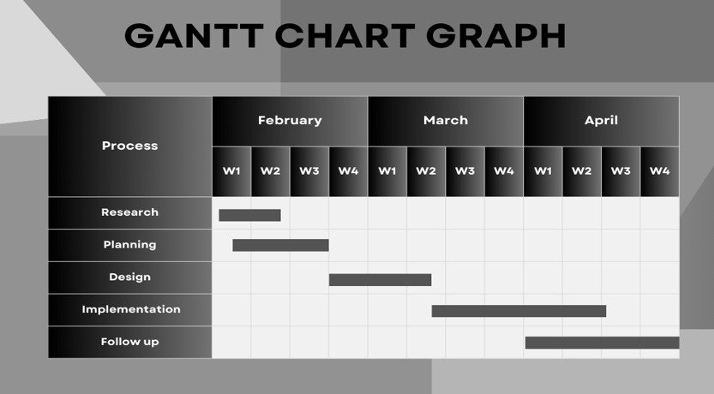
TIMELINE OF THE PROJECT

Slide 6
INTRODUCTION
Audio classification is an Application of machine learning where different sound is categorized in certain categories.
The music genre classification can be built using different approaches in which the top 4 approaches that are mostly used are listed below.
Multiclass support vector machine
K-Nearest Neighbors
K-means clustering algorithm
Convolutional neural network.
We will use K-Nearest Neighbors algorithm because various researches prove it is one of the best algorithms to give good performance and till time along with optimized models organizations uses this algorithm in recommendation systems as support.
K-Nearest Neighbour (KNN) is a machine learning algorithm used for regression, and classification. It is also known as the lazy learner algorithm. It simply uses a distance-based method to find the K number of similar Neighbours to new data and the class in which the majority of Neighbours lies, it results in that class as an output.

Slide 7
LITERATURE REVIEW
Sl.No | Author’s Name | Paper name and publication details | Year of publication | Main content of the paper
1 | Ossama Abdel-Hamid, Abdel-rahman Mohamed, Hui Jiang, Li Deng, Gerald Penn, and Dong Yu | IEEE/ACM Transactions on audio, speech, and language processing 22(10):1533–1545. | 2020 | Convolutional neural networks for speech recognition
2 | Lam Hoang | ACM Symposium on Neural Gaze Detection, Woodstock, NY . ACM, New York, NY, USA, 3 pages. https://doi.org/10.1145/ 1122445.112245. | 2018 | Literature Review about Music Genre Classification. In Woodstock ’18
3 | Hareesh Bahuleyan | CoRR, abs/1804.01149 | 2018 | Music genre classification using machine learning techniques
4 | Prajwal R*1, Shubham Sharma*2, Prasanna Naik*3, Mrs. Sugna Mk*4 | IN Volume:03/Issue:07/July-2021 | 2021 | AI AUDITOR: CRAFTING YOUR PERFECT PLAYLIST WITH MACHINE LEARNING

Slide 8
DESIGN AND METHODOLOGIES
MODULE 1:- Implementation of Music Genre Classification.
Step 1: Import required libraries.
Step 2: Processing of data.
Step 3: Apply Machine Learning Algorithms(KNN).
Step 4: Identify the nearest neighbors.

Slide 9
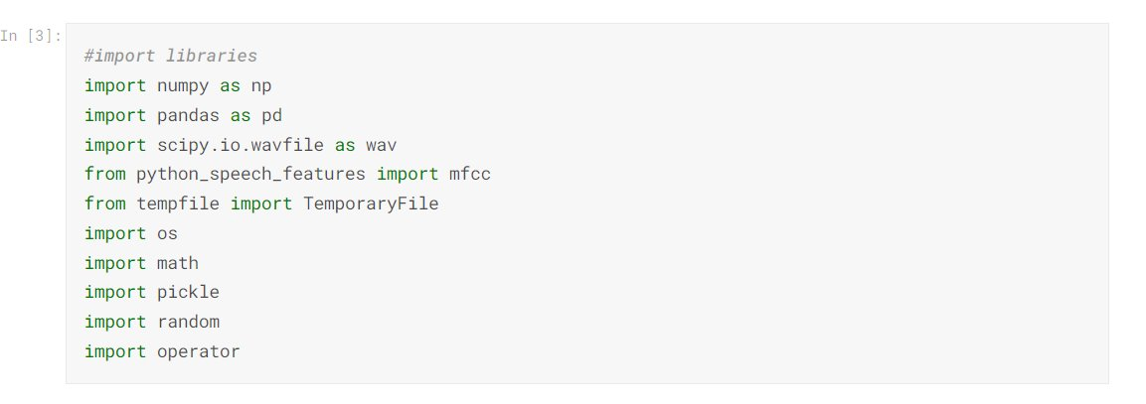
MODULE 1: Mention name of the module 1(eg: decision tree)
Step:1 :- Import required libraries.
Eg,

Slide 10
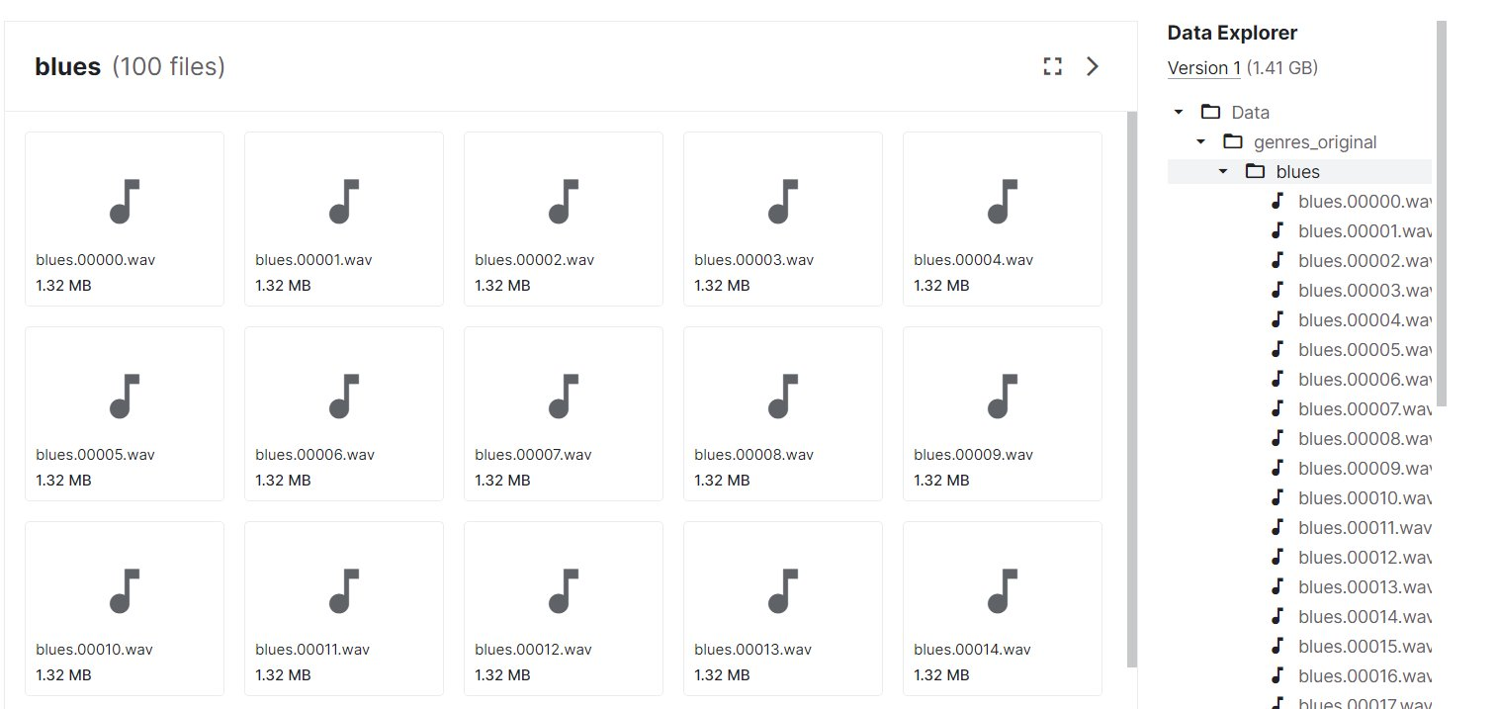
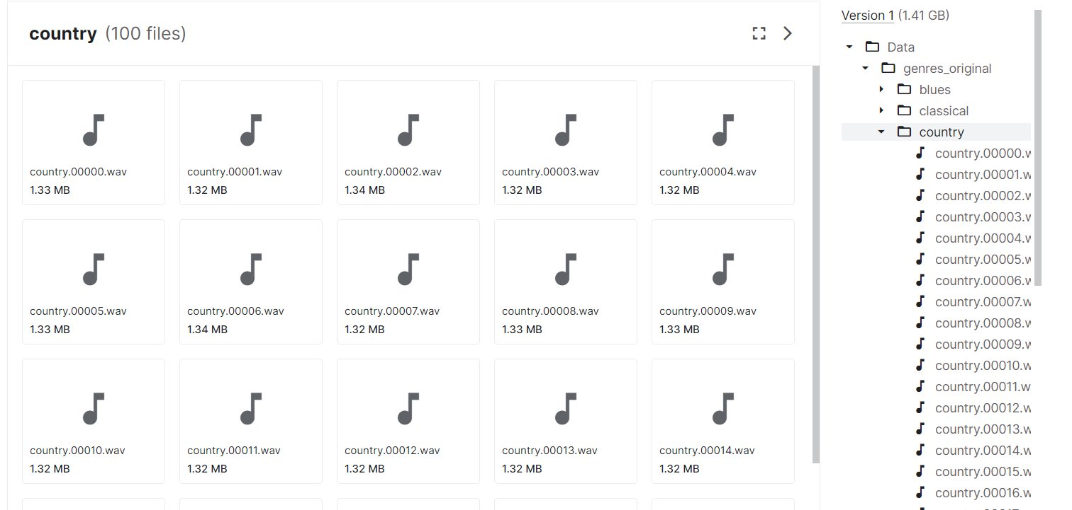
Step 2: Processing of data.

Slide 11
Step 3: Using algorithm’s name algorithm
K-Nearest Neighbour Algorithm (KNN)​
One of them, K-Nearest Neighbour (KNN), is a technique that has been reportedly successful in categorizing music into different genres. Let us find out how.​
A supervised machine learning algorithm, the K-Nearest Neighbour technique is used to find solutions for classification and regression problems. Relying on labeled input data to process unlabeled data in the future, this ML technique is used in music genre classification. ​
Step 1: Select the value of K neighbors(say k=5)​
Step 3 : Find the K(5) nearest data point for our new data point based on Euclidean distance(which we discuss later)​
Step 3: Among these K data points count the data points in each category​
Step 4: Assign the new data point to the category that has the most neighbors of the new datapoint

Slide 12
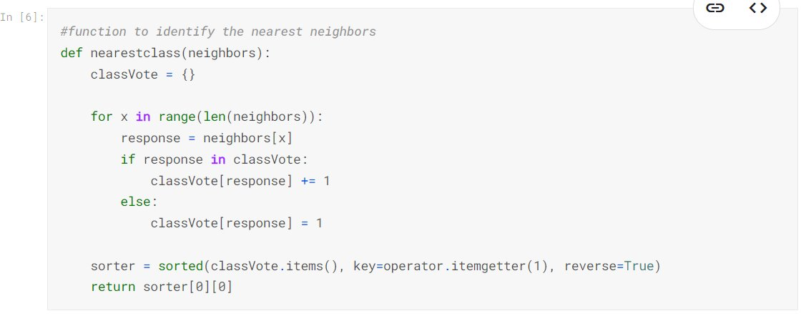
Step 4: Identify the nearest neighbors

Slide 13
IMPLEMENTATION
Architecture Diagram
Data –Flow Diagram
Use Case Diagram
Class Diagram
Activity Diagram

Slide 14
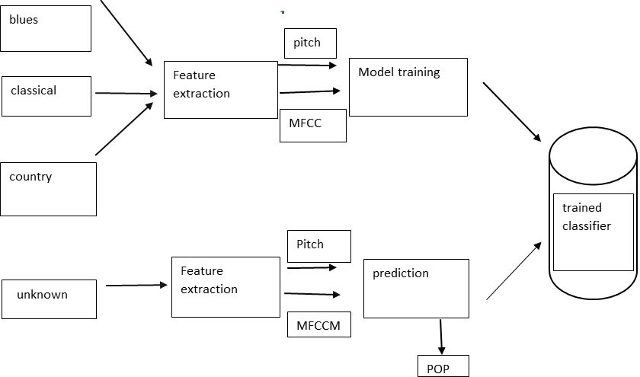
Architecture Diagram

Slide 15
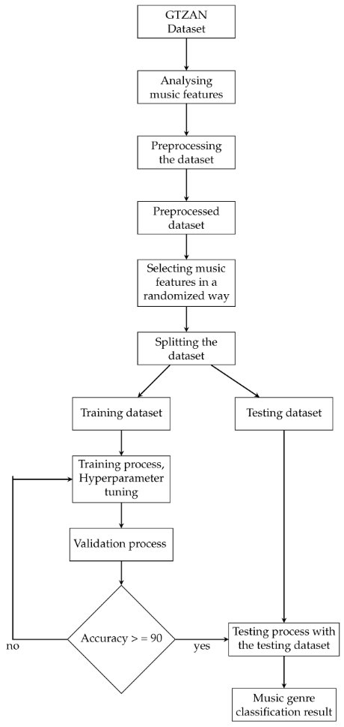
Data –Flow Diagram

Slide 16
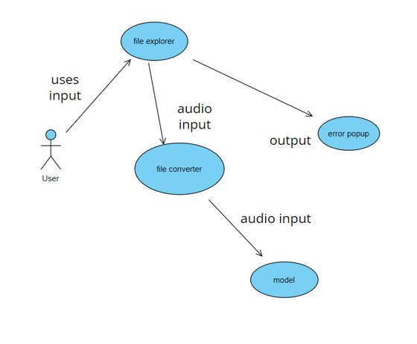
Use Case Diagram

Slide 17
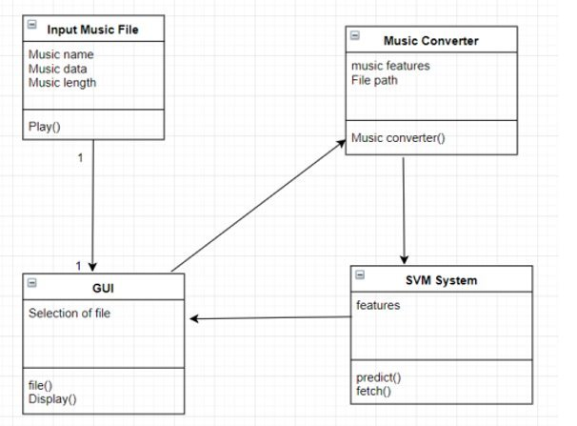
Class Diagram

Slide 18
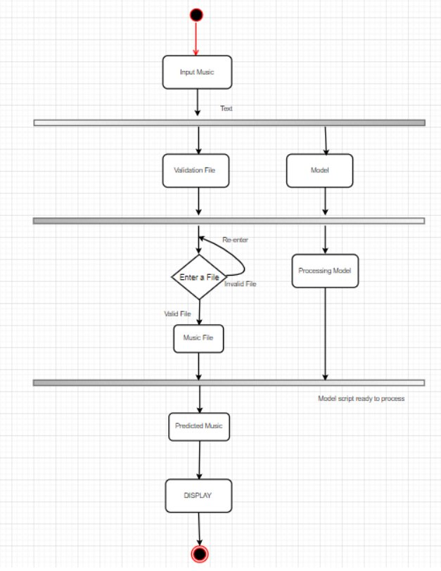
Activity Diagram

Slide 19
TESTING
UNIT TESTING
INTEGRATION TESTING
FUNCTIONAL TESTING

Slide 20
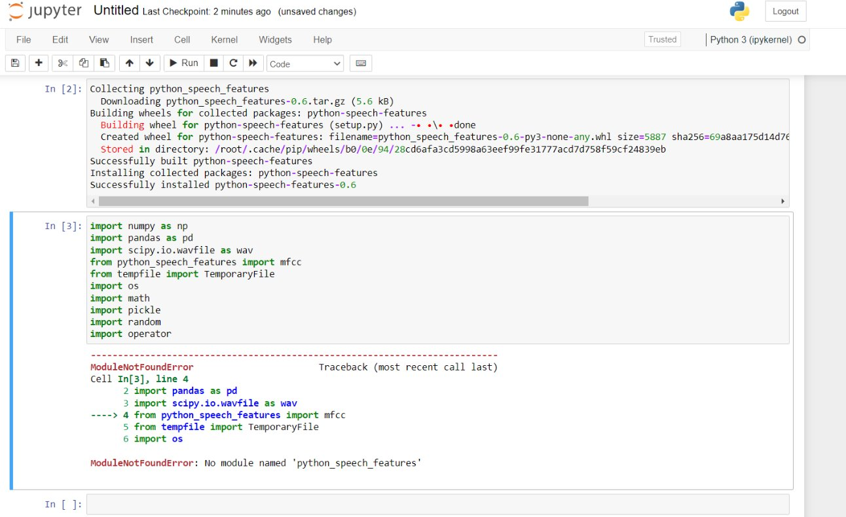
UNIT TESTING
The first level of testing software is unit testing: they allow us to test the smallest unit of code that makes logical sense to isolate within a system. The cool thing about unit tests is they can be anything you want them to be although it’s usually a function, class, or line of code in most programming languages.

Slide 21
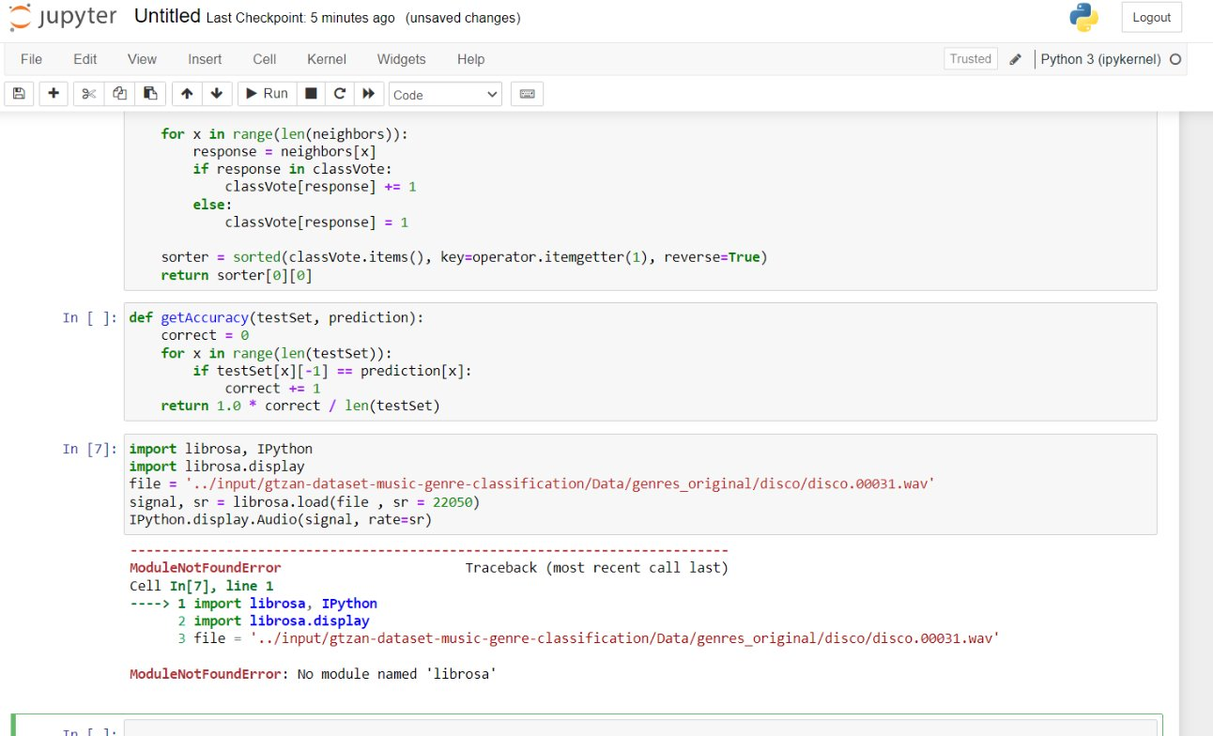
INTEGRATION TESTING
Integration tests: come after unit tests. The main purpose of integration tests is to find out any irregularity between the interactions of different components of the software.
After unit tests, it’s useful to test how components work together. For that, we use integration testing. Integration testing doesn’t necessarily mean testing the whole ML project altogether but one logical part of the project as a single unit.

Slide 22
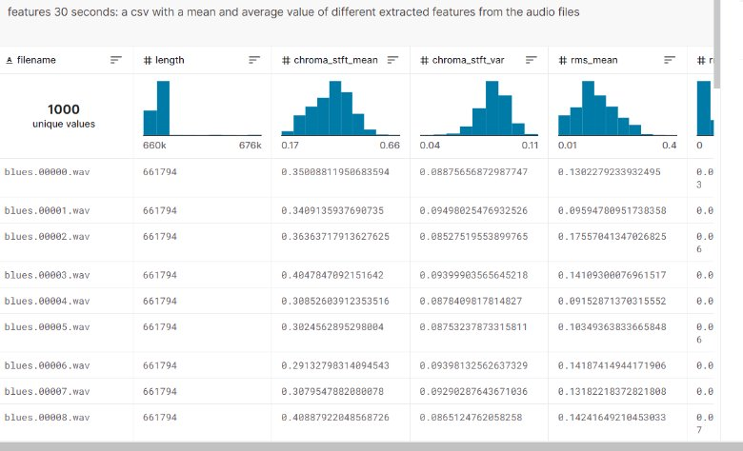

INPUT

Slide 23
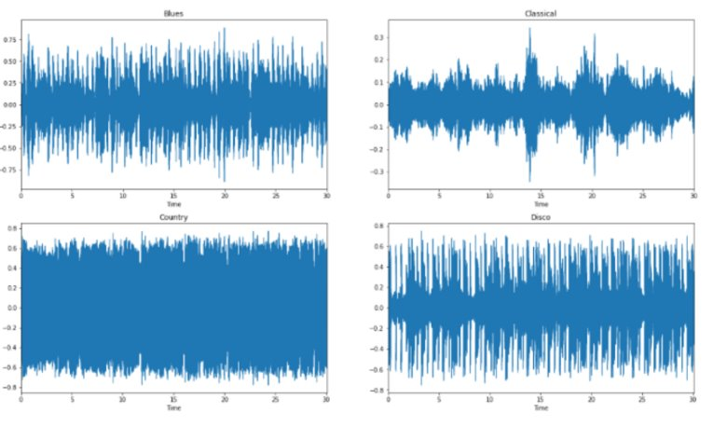
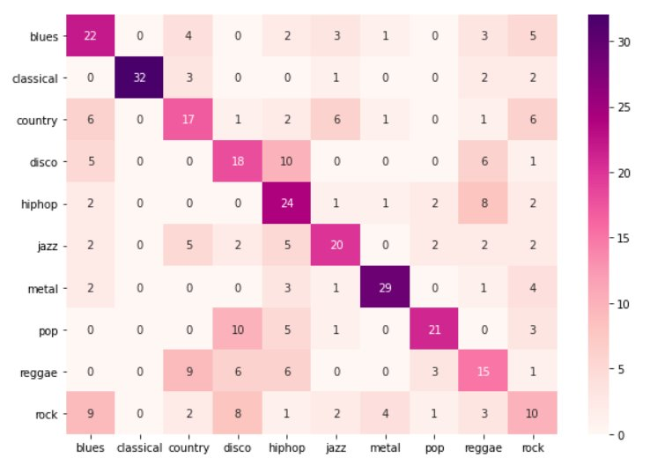
OUTPUT

Slide 24
CONCLUSION
The proposed KNN model has shown improved performance in terms of music genre classification, music similarity and music recommendation, compared to previous studies. In particular, adding some dropout layers into CNN have provided much better results. Owing to the fact that the KNN has only three layers, it is an appropriate model to employ in the music streaming applications for music similarity and recommendation. When the performance results are examined, some similar music genres can lead to mis-classification and mis-recommendation such as Jazz and Classic. In future studies, in order to improve current results, we plan to design more comprehensive deep neural network models and to add extra data models as an input in addition to using only spectrogram. Big data processing techniques and tools can also be utilized for feature extraction and model creation in music genre recommendation systems.

Slide 25
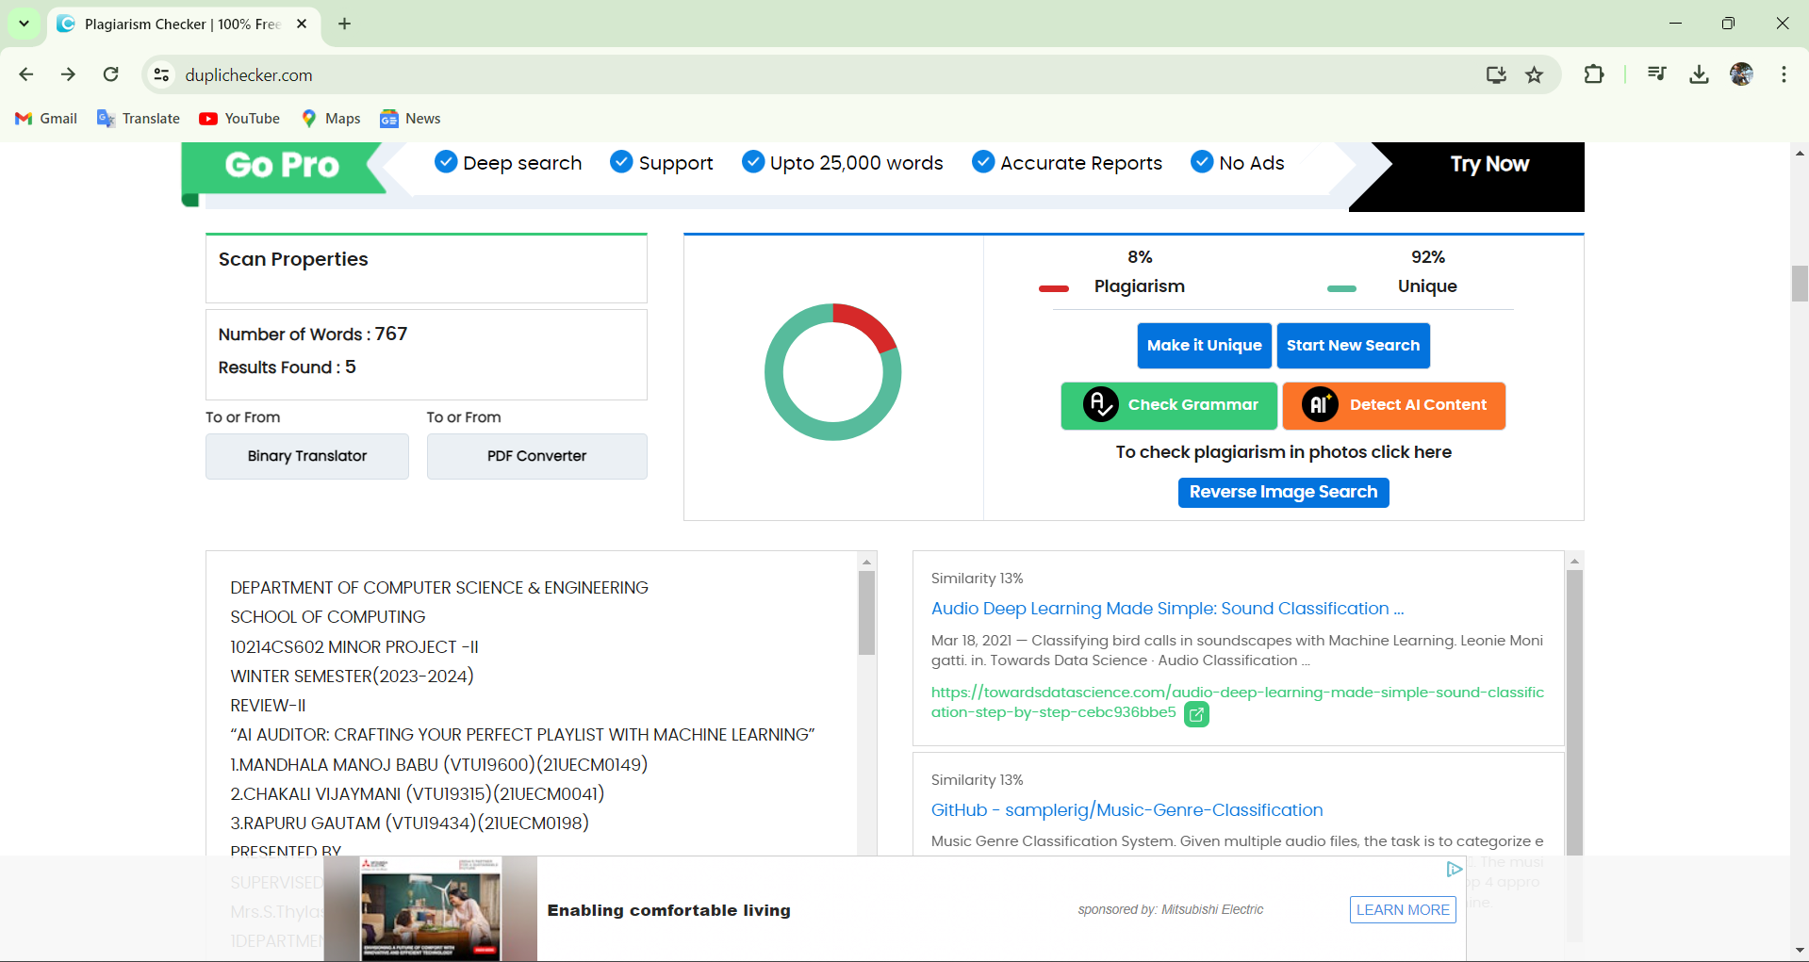
Plagiarism Report of PPT

Slide 26
Web references/video links
https://www.kaggle.com/andradaolteanu/gtzandataset-music-genre-classification
https://www.analyticsvidhya.com/blog/2022/03/music-genre-classification-project-using-machine-learning-techniques/
https://www.clairvoyant.ai/blog/music-genre-classification-using-cnn
https://www.geeksforgeeks.org/music-genre-classifier-using-machine-learning/
https://www.analyticssteps.com/blogs/music-genre-classification-using-machine-learning

Slide 27
REFERENCES
A. Kayatana and O. Yildiz, “Music genre classification with machine learning techniques,” in Signal Processing and Communications Applications Conference (SIU), 2017 25th, IEEE, 2019, pp. 1–4.
A. Tsantakis, G. and Cook, P. “Musical genre classification of audio signal”, IEEE Transactions on Speech and Audio Processing, Vol. 10, No. 3, pp. 293-302, July 2020.
Holzapfel, A. and Stylianou Y. “Musical genre classification using nonnegative matrix factorization-based features”, IEEE Transactions on Audio, Speech, and Language Processing, Vol. 16, No. 2, pp. 424-434, 2019.
Sturm, B. L. (2020). The GTZAN dataset: Its contents, its faults, their effects on evaluation, and its future use. Ariv preprintarXiv:1306.1461.
Gemmate, J. F., Ellis, D. P., Freedman, D., Jansen, A., Lawrence, W., Moore, R. C., ... & Ritter, M. (2017, Mar EEE International Conference on Acoustics, Speech and Signal Processing (ICASSP) (pp. 776-780) IEEE. Audio set: An ontology and human-labelled dataset for audio events. In 2020

Slide 28
THANK YOU

